Slide 1
Linear Regression
Matrix Representation of Linear Regression?

Slide 2
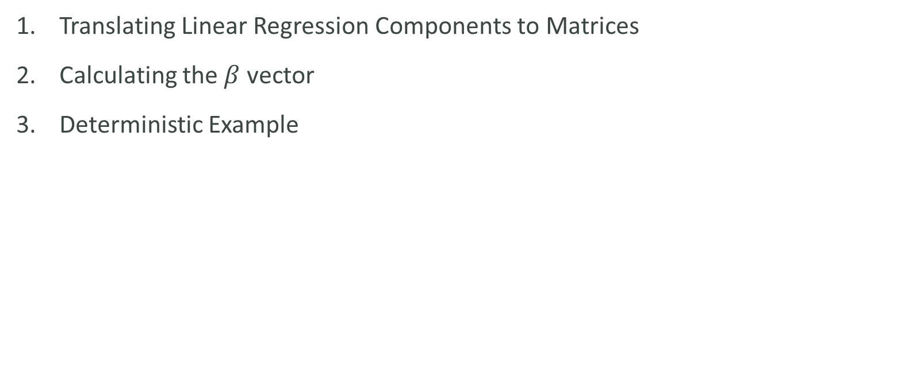
Outline
Translating Linear Regression Components to Matrices
Calculating the $β$ vector
Deterministic Example

Slide 3
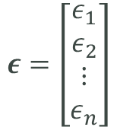
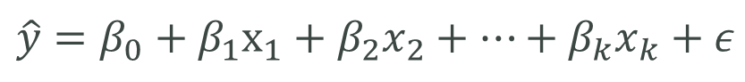
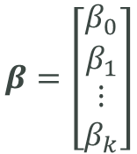
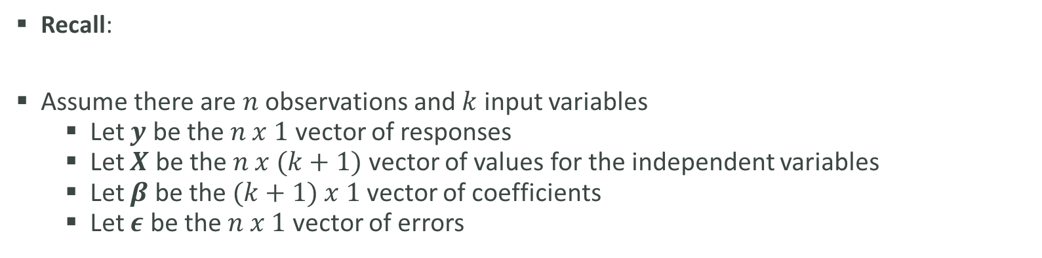
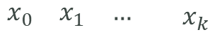
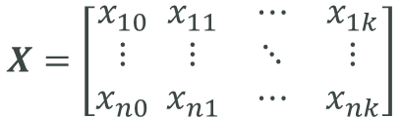
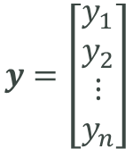
Translating Linear Regression Components to Matrices
Recall:
Assume there are $n$ observations and $k$ input variables
Let $y$ be the $n x 1$vector of responses
Let $X$ be the $n x (k+1)$vector of values for the independent variables
Let $β$ be the $(k+1) x 1$vector of coefficients
Let $ε$ be the $n x 1$ vector of errors
$$\hat{y}=β_{0}+β_{1}x_{1}+β_{2}x_{2}+…+β_{k}x_{k}+ε$$
$$\begin{matrix}x_{0} & x_{1} & …\end{matrix}\begin{matrix} & x_{k}\end{matrix}$$
$$y=\left[\begin{matrix}y_{1} \\ y_{2} \\ ⋮ \\ y_{n}\end{matrix}\right]$$
$$β=\left[\begin{matrix}β_{0} \\ β_{1} \\ ⋮ \\ β_{k}\end{matrix}\right]$$
$$ε=\left[\begin{matrix}ε_{1} \\ ε_{2} \\ ⋮ \\ ε_{n}\end{matrix}\right]$$
$$X=\left[\begin{matrix}x_{10} \\ ⋮ \\ x_{n0}\end{matrix} \begin{matrix}x_{11} & ⋯ & x_{1k} \\ ⋮ & ⋱ & ⋮ \\ x_{n1} & ⋯ & x_{nk}\end{matrix}\right]$$

Slide 4
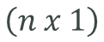
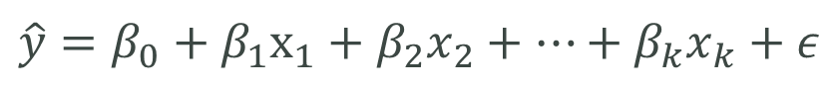
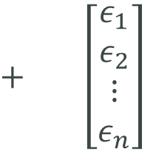

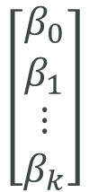
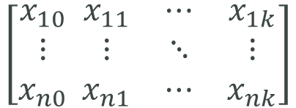
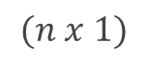
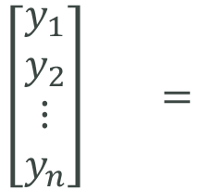
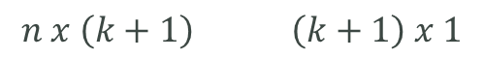
Translating Linear Regression Components to Matrices
The model then becomes:
$$y=Xβ+ε$$
$$\hat{y}=β_{0}+β_{1}x_{1}+β_{2}x_{2}+…+β_{k}x_{k}+ε$$
$$\left[\begin{matrix}y_{1} \\ y_{2} \\ ⋮ \\ y_{n}\end{matrix}\right] =$$
$$\left[\begin{matrix}β_{0} \\ β_{1} \\ ⋮ \\ β_{k}\end{matrix}\right]$$
$+ \left[\begin{matrix}ε_{1} \\ ε_{2} \\ ⋮ \\ ε_{n}\end{matrix}\right]$
$$\left[\begin{matrix}x_{10} \\ ⋮ \\ x_{n0}\end{matrix} \begin{matrix}x_{11} & ⋯ & x_{1k} \\ ⋮ & ⋱ & ⋮ \\ x_{n1} & ⋯ & x_{nk}\end{matrix}\right]$$
$$\left(n x 1\right)$$
$$n x \left(k+1\right) \left(k+1\right) x 1$$
$$(n x 1)$$

Slide 5


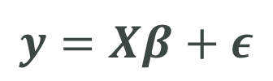
Calculating the $β$ vector
$$y=Xβ+ε$$
The challenge then becomes to find the values in the $β$ vector.
It turns out this can be found as follows:
$$β={\left(X^{T}X\right)}^{−1}X^{T}y$$

Slide 6
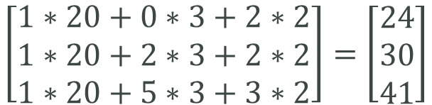
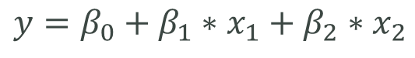
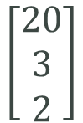
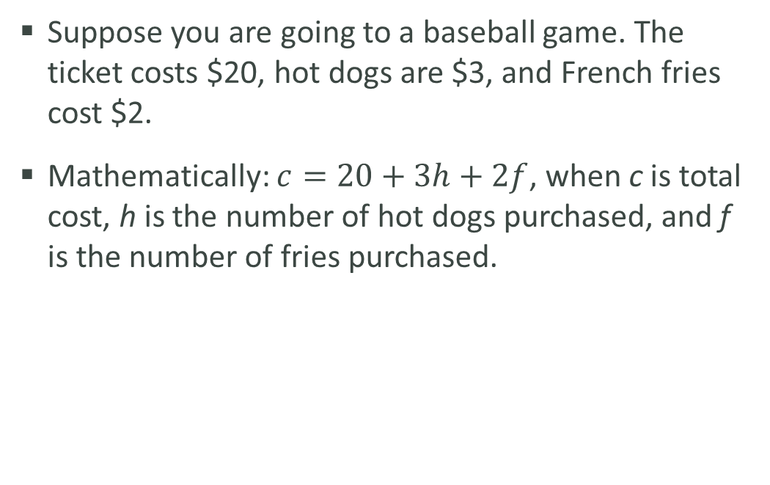
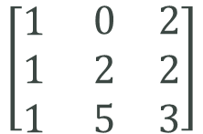
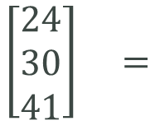
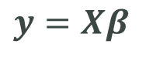
Deterministic Example
Suppose you are going to a baseball game. The ticket costs $20, hot dogs are $3, and French fries cost $2.
Mathematically: $c=20+3h+2f$, when c is total cost, h is the number of hot dogs purchased, and f is the number of fries purchased.
Hot Dogs | French Fries | Total Cost
0 | 2 | $24
2 | 2 | $30
5 | 3 | $41
$$y=β_{0}+β_{1}∗x_{1}+β_{2}∗x_{2}$$
$$y=Xβ$$
$$\left[\begin{matrix}24 \\ 30 \\ 41\end{matrix}\right] =$$
$$\left[\begin{matrix}1 \\ 1 \\ 1\end{matrix} \begin{matrix}0 & 2 \\ 2 & 2 \\ 5 & 3\end{matrix}\right]$$
$$\left[\begin{matrix}20 \\ 3 \\ 2\end{matrix}\right]$$
$$\left[\begin{matrix}1∗20+0∗3+2∗2 \\ 1∗20+2∗3+2∗2 \\ 1∗20+5∗3+3∗2\end{matrix}\right]=\left[\begin{matrix}24 \\ 30 \\ 41\end{matrix}\right]$$
✓

Slide 7
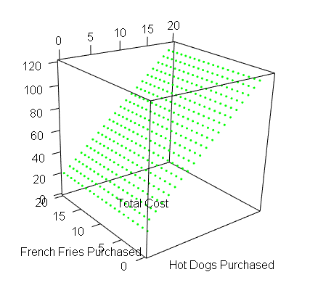

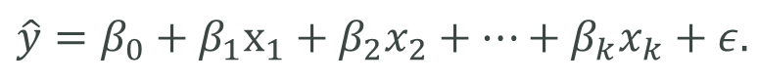
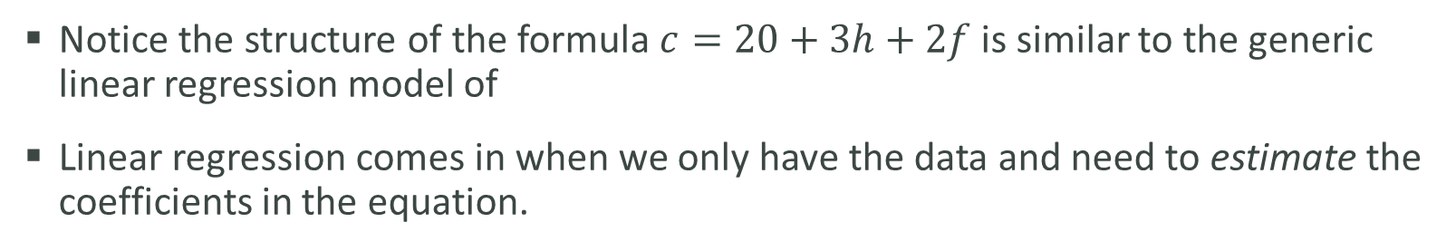
Deterministic Example
Notice the structure of the formula $c=20+3h+2f$ is similar to the generic linear regression model of
Linear regression comes in when we only have the data and need to estimate the coefficients in the equation.
$$\hat{y}=β_{0}+β_{1}x_{1}+β_{2}x_{2}+…+β_{k}x_{k}+ε.$$

Slide 8
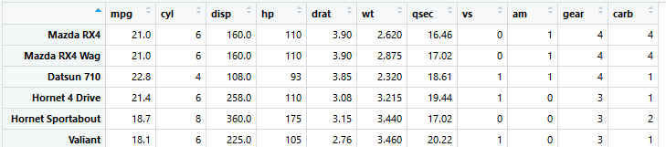
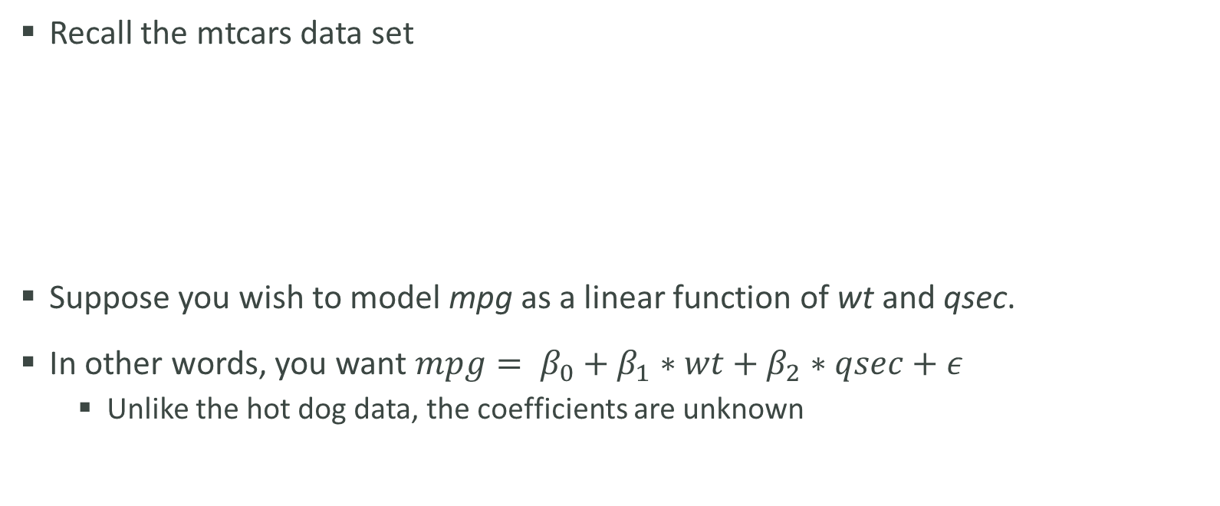
Stochastic Example
Recall the mtcars data set
Suppose you wish to model mpg as a linear function of wt and qsec.
In other words, you want $mpg= β_{0}+β_{1}∗wt+β_{2}∗qsec+ε$
Unlike the hot dog data, the coefficients are unknown

Slide 9
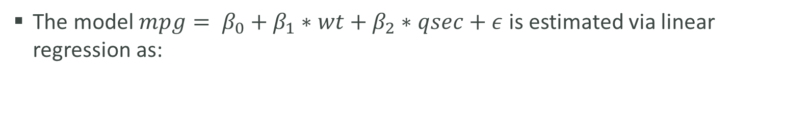
Stochastic Example
The model $mpg= β_{0}+β_{1}∗wt+β_{2}∗qsec+ε$ is estimated via linear regression as:
$$mpg=19.75+(−5.05)∗wt+0.93∗qsec+ε$$
wt | qsec | mpg
1.5 | 14.5 | 19.75 - 5.05*1.5 + 0.93*14.5 = 24.9
3.3 | 17.7 | 19.75 - 5.05*3.3 + 0.93*17.7 = 19.5
5.4 | 22.9 | 19.75 - 5.05*5.4 + 0.93*22.9 = 13.7

